Slide 1





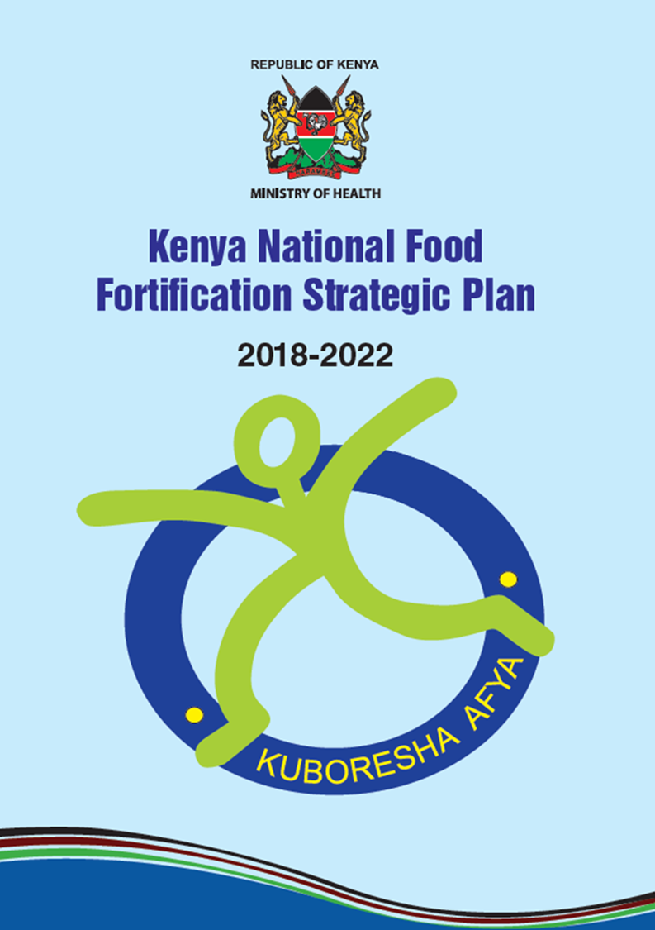
Strengthening Kenya National Food Fortification Program
Prof. Daniel Ndaka Sila
Project Manager: EU funded fortification project
Jomo Kenyatta University of Agriculture and Technology
P.O Box 62000-00200, Nairobi
Email: dsila@jkuat.ac.ke

Slide 2
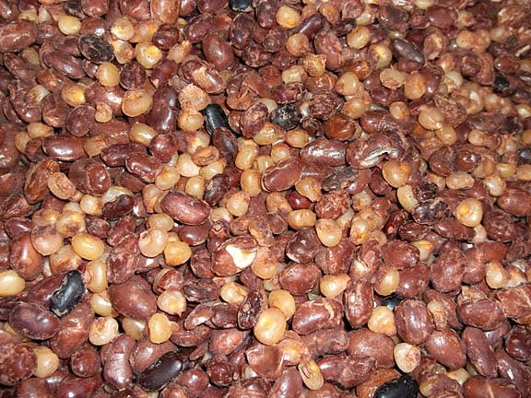
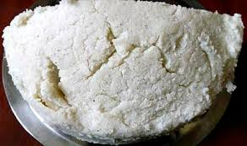

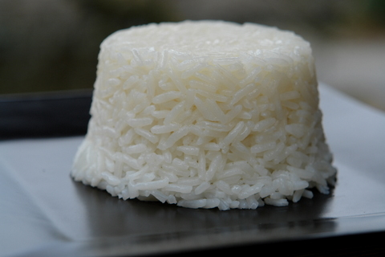
Eating Pattern In Kenya -Starchy Staples
Githeri
Ugali
Chapati
Rice
Most Starchy staples: Poor in proteins, micronutrients and vitamins

Slide 3

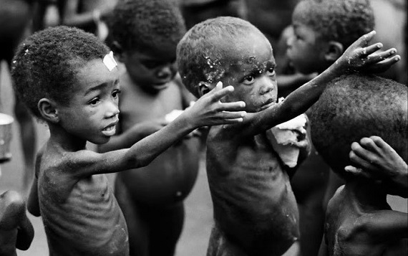
Nutrition Situation in Kenya (KDHS, 2014)

Slide 4
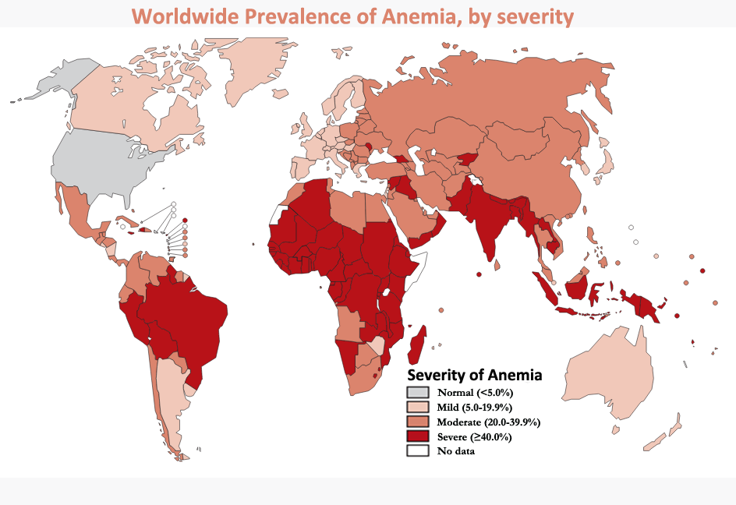

Slide 5




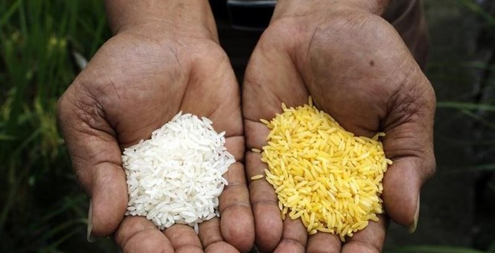
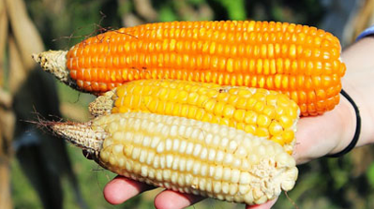
Interventions by MoH & Partners
    Nutrition education on diet diversification
    Supplementation
    Biofortification of some foods
    Fortification of staple foods

Slide 6
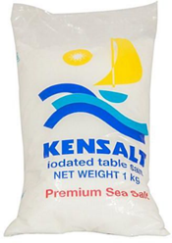
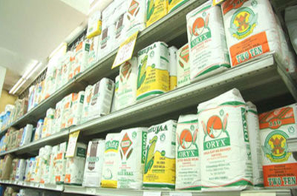


Fortification Legislation in Kenya
The Regulation/ Act of Parliament:
Kenya Foods, Drugs and Chemical Substance Act (CAP 254, Notice No 62, June 2012) amended in 2012 to include mandatory fortification of all packaged maize meal, wheat flours and edible fats & oils with specific vitamins and minerals.

Slide 7

Strategic objective
Creating an enabling environment (policies and strategies)
Scaling up the current national food fortification
Improving the implementation of existing and new food fortification programmes in Kenya
Raising awareness on consumption of fortified foods
Improving monitoring and evaluation of existing and new programmes

Slide 8
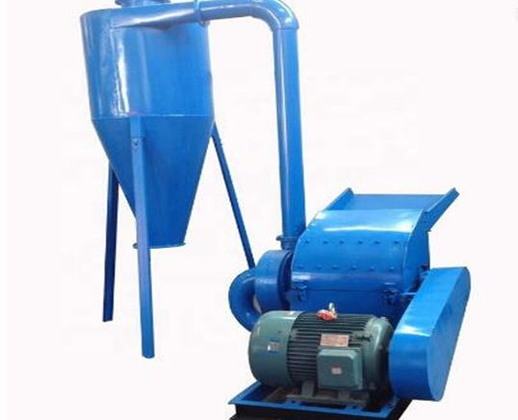
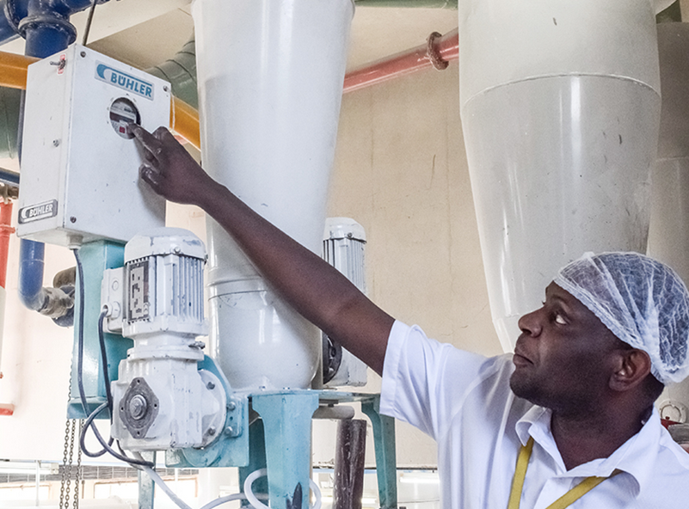
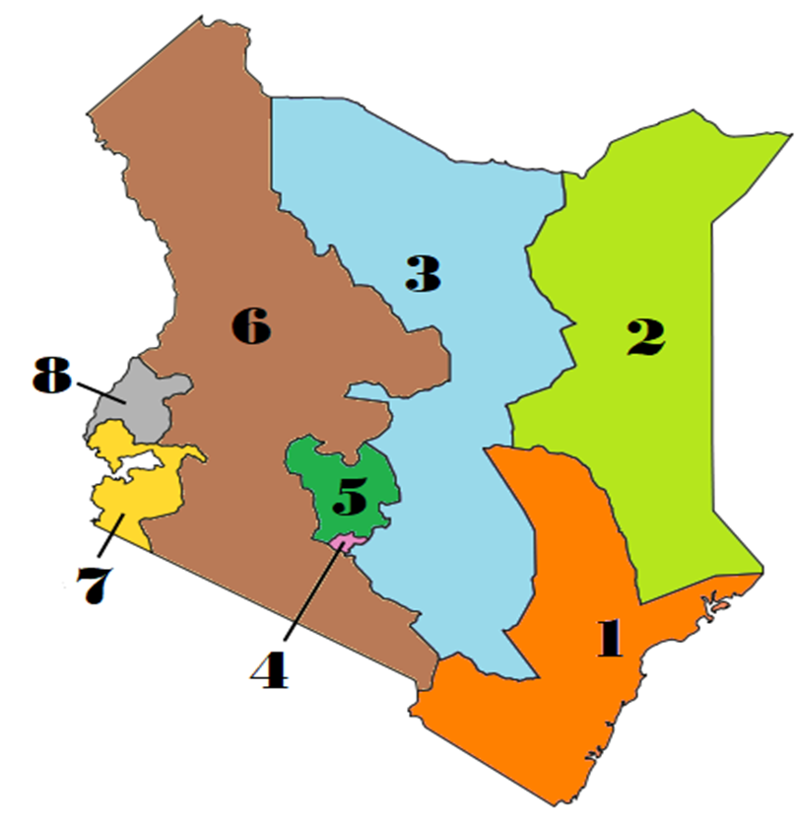
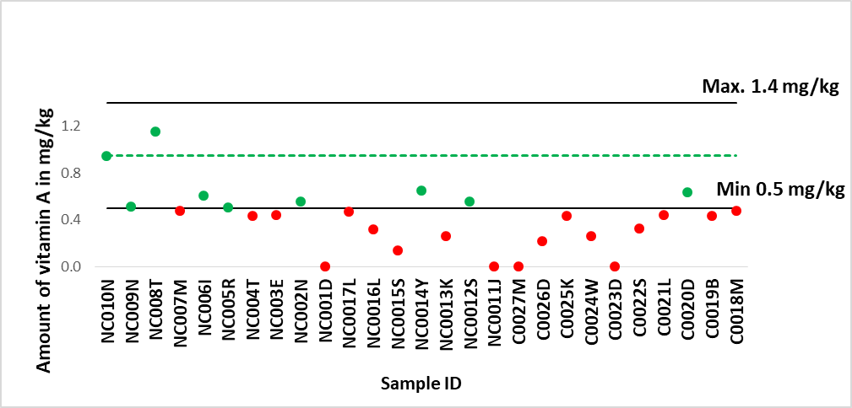
Main Challenges to food fortification: 4C concept
Capacity equipment installed capacity, types, compatibility….
Capability personnel knowledge and skills
Compliance
Coverage
Brand performance compared to set standards
% population reached

Slide 9

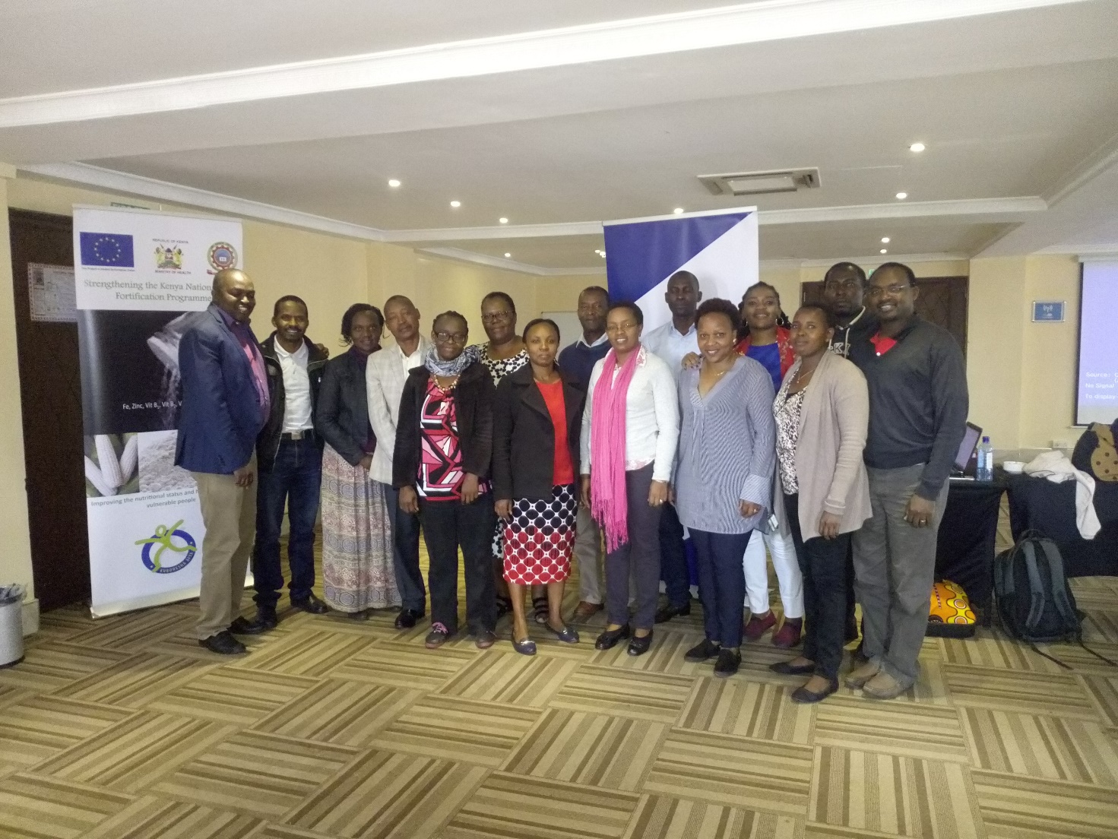
Possible Interventions: Training Guideline
Fortification training guideline development committee at Gelian Hotel, Machakos on 13th to 15th August 2018.

Slide 10
Purpose of the training guide
Goal: to provide the necessary technical knowledge and skills to flour fortification stakeholders to improve efficiency and compliance with the national and regional food fortification requirements
Objectives
To improve the level of knowledge and awareness on the national food fortification program in Kenya.
To enhance the competence and skills for implementing flour fortification among industry (millers), equipment fabricators, regulators, and other relevant stakeholders.
To improve the knowledge and skills in QA/QC to ensure safety of fortified foods and assure a consistent quality throughout the production process.

Slide 11

Content of the Training Guideline
Background information: Why fortification
Objectives
Regulatory framework: Legislation & Standards
Fortification at Industry level
Premix
Fortification Equipment
Quality Assurance and Quality Control
Packaging and Labelling
Appendix

Slide 12
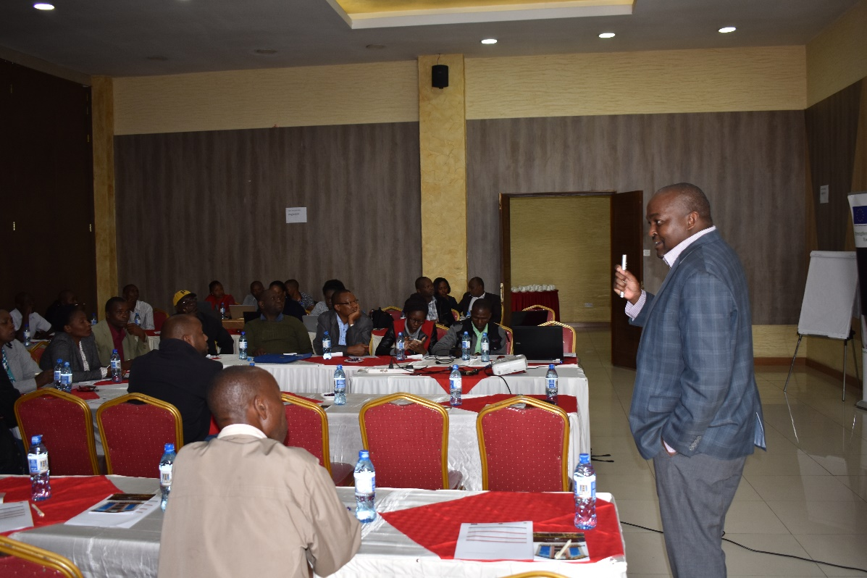
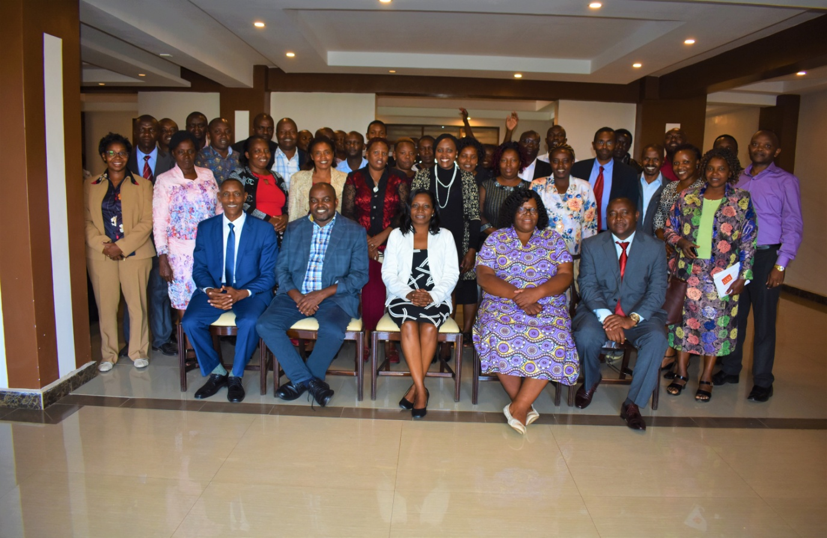
Capacity building in numbers
S/No. | Intervention Category | Number of People | Period
2. | Industrial players; Millers/QA | 156 | 2019
3. | Public Health Officer | 270 | 2019/2020
Maize millers training , Nakuru - June 2019
Training Public Health Officers, Kiambu - Jan 2020

Slide 13








The European Union
Representatives from Industry
Asante Sana

